Slide 1


Year 6 SATs
Parents’ Briefing

Slide 2
Aims of this session…
To explain what the SATs are
To give an idea as to what the tests involve and when they will take place
To explain what we in school are doing to help and support your child
To share ways to help support your child at home
To provide an opportunity for you to ask questions

Slide 3
What are the SATs tests?
SATs stands for Standardised Assessment Tests
SATs are public examinations which are marked outside of school
They assess the attainment of Year 6 pupils in the core subjects of Maths and English.
Many secondary schools use Year 6 SATs results to determine what set a child will be assigned to in Year 7. Obviously, as a middle school, we are in a slightly different situation and we don’t set pupils in the same way, however pupils’ SATs results, along with teacher assessment, will be used to set targets as they move into Key Stage 3.
Whilst Secondary/High schools may also do their own tests to help assess children, they are likely to use Year 6 English and Maths SATs data to help generate targets as pupils move towards their GCSE pathways.

Slide 4
Year 6 SATs are during the week of…
Monday 11th – Thursday 14th May
No Year 6 absence during this week please (where possible).

Slide 5
What is expected by the end of KS2?
A scaled score of 100 or more means a child is working at the expected standard, whilst a score below 100 indicates that a child hasn’t yet reached the government expected standard and is working towards this. The maximum score possible is 120 and the minimum is 80.

Slide 6
Ensuring the best results for your child – parental support
Helping your child with their homework, hear them read and support them in learning their multiplication tables and spellings.
Make sure that your child has the correct equipment – black pen, pencil, ruler etc.
Please ask your child how their mock tests went and if there is anything they would like to work on.
Encourage your child to do their best.
Ensure that your child sleeps well that week.

Slide 7
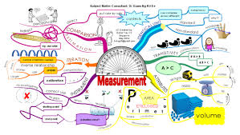
Preparing for the tests: Revision
Plenty is being done in school to prepare your child for the SATs tests, but encouraging them to go over key things at home may well give them that extra bit of confidence.
Post-its
Mind maps
TT Rockstars, Spelling Shed,
SPaG.com, Freckle
Revision booklets/resources (CGP)
On-line games (e.g. BBC Bitesize etc.)
Get them to, ‘be the teacher!’

Slide 8
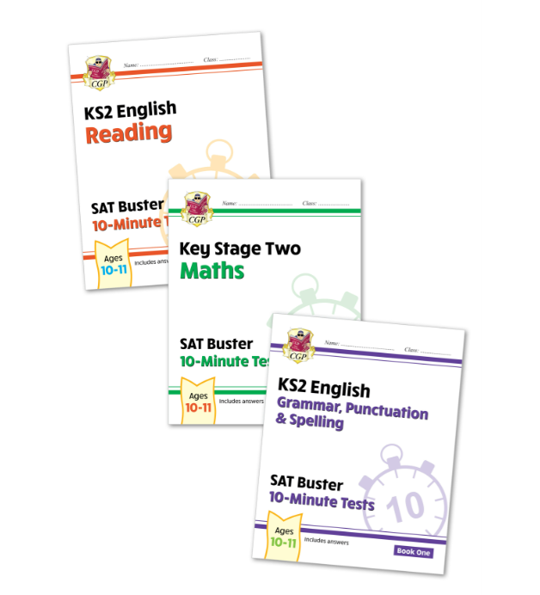
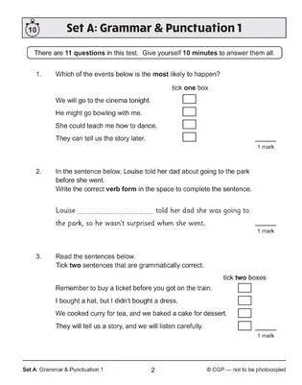
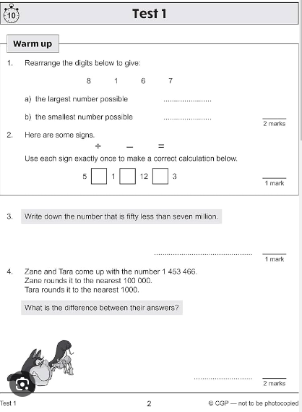
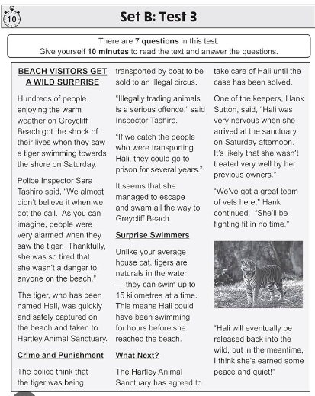
Complete KS2 Maths and English 10-Minute Test SAT Buster Book 1 Bundle (for the 2026 tests)

Slide 9
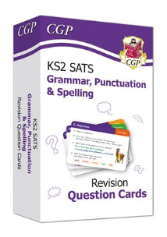
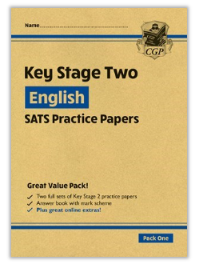
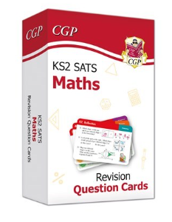

https://www.cgpbooks.co.uk/
£7.08 each + VAT
£6.50 + VAT
CGP SATs Revision material are also available on Amazon.

Slide 10
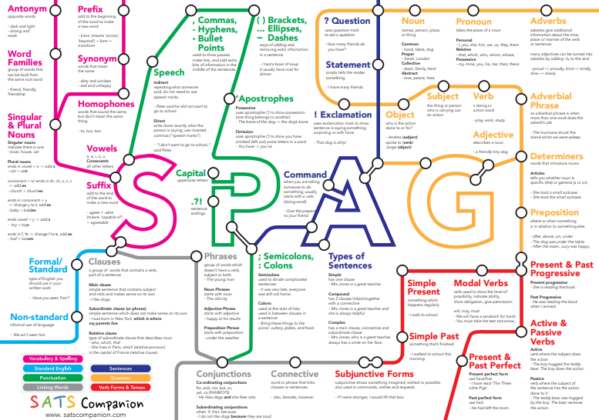
Resources
SPAG roadmap
Maths vocabulary pack
Parent and carer information booklet

Slide 11
Ensuring the best results for your child – school support
The Year 6 children will have had numerous practice assessment weeks allowing them to feel more confident when it comes to the actual tests
Free snack for each child in Year 6 during the Revision Lessons prior to the tests during SATs Week.
Pastoral support for pupils who may feel the pressure in the lead up to the tests.
Tests will take place in familiar environments.

Slide 12
Ensuring the best results for your child – school support
Each child will be treated as an individual
Programmes of support have already been put in place – Interventions and Booster Sessions led by Teaching Assistants and Tutors as well as small group support within lessons.
Some pupils will receive additional one to one or small group support during SATs Week and may sit their tests in different rooms to allow that support to take place.
Revision material (including on-line support) will be/has been provided.

Slide 13
Test Timetable
Monday 11th May | English Grammar, Punctuation and Spelling Test (SPaG): Paper 1 - short answer questions Paper 2 – Spelling
Tuesday 12th May | English Reading Test: Reading Booklet and associated Answer Booklet
Wednesday 13th May | Mathematics: Paper 1 - Arithmetic Test, Paper 2 - Reasoning
Thursday 14th May | Mathematics: Paper 3 - Reasoning

Slide 14
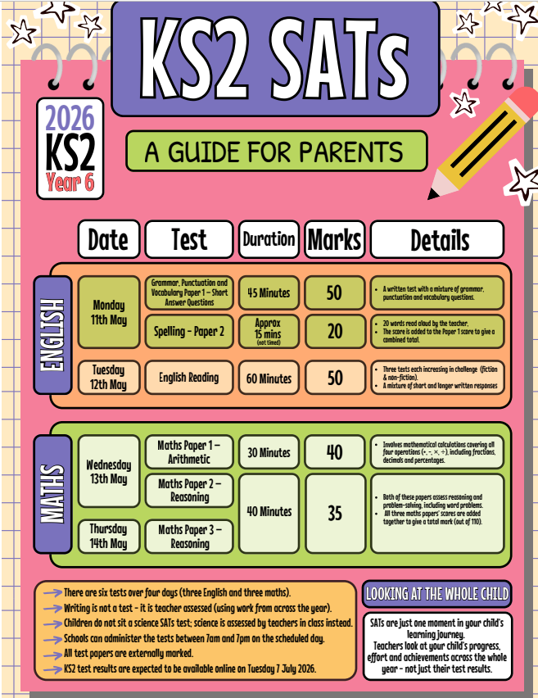

Slide 15
When and how are the SATs carried out?
The tests will take place during normal school hours, under exam conditions.
Children are not allowed to talk to each other from the moment the assessments are handed out until they are collected in after the test has ended.
Afterwards, the completed papers are sent away to be marked externally.
The children’s results are sent back to school at some point in July.
The standard timings of tests differ but last no more than 60 minutes:
- Grammar, Punctuation and Spelling (Paper 1) – 45 minutes;
- Grammar, Punctuation and Spelling (Paper 2) – 15 minutes;
- Reading – 60 minutes;
- Maths Paper 1 (Arithmetic) – 30 minutes;
- Maths Paper 2 (Reasoning) – 40 minutes;
- Maths Paper 3 (Reasoning) – 40 minutes.

Slide 16

After SATs…
As a reward for all their hard work in the lead up to SATs week, a special day of rewards will be organized for our wonderful Year 6 pupils once the tests have been completed.
TBC: More details will be given to confirm activities closer to the date.
It’s the very least they deserve!

Slide 17


Slide 18

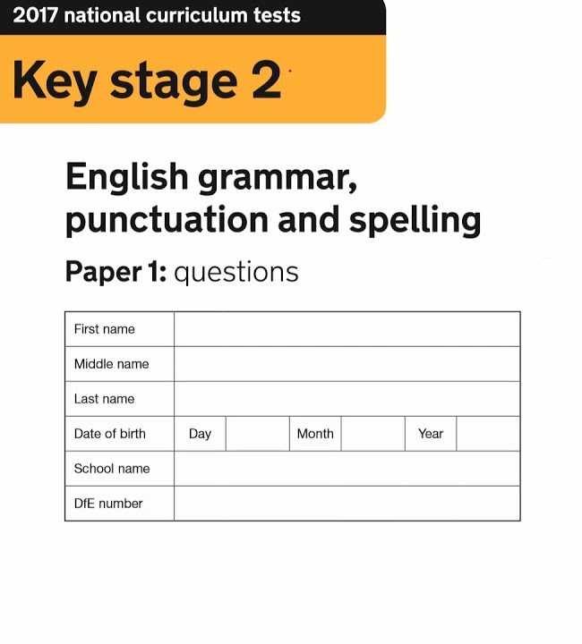
What exams will my child sit for English?

Slide 19

Spelling, Punctuation and Grammar
1x45 minute paper on general spelling, punctuation and grammar
1x15 minute (approx.) paper on spelling only
Reading
1x60 minute paper, comprised of 3 different texts
Writing
assessed by teachers throughout the year – no exam

Slide 20
Monday 11th May 2026
Paper 1: Grammar, Punctuation and Spelling
The children will be prepared by their class teacher so they are equipped with a good knowledge of the technical vocabulary needed to identify and describe various aspects of grammar and punctuation marks.
Grammar, Punctuation and Spelling (Paper 1) requires a range of answer types such as circling missing capital letters, multiple choice questions, one-word answers, but does not require longer formal answers.

Slide 21
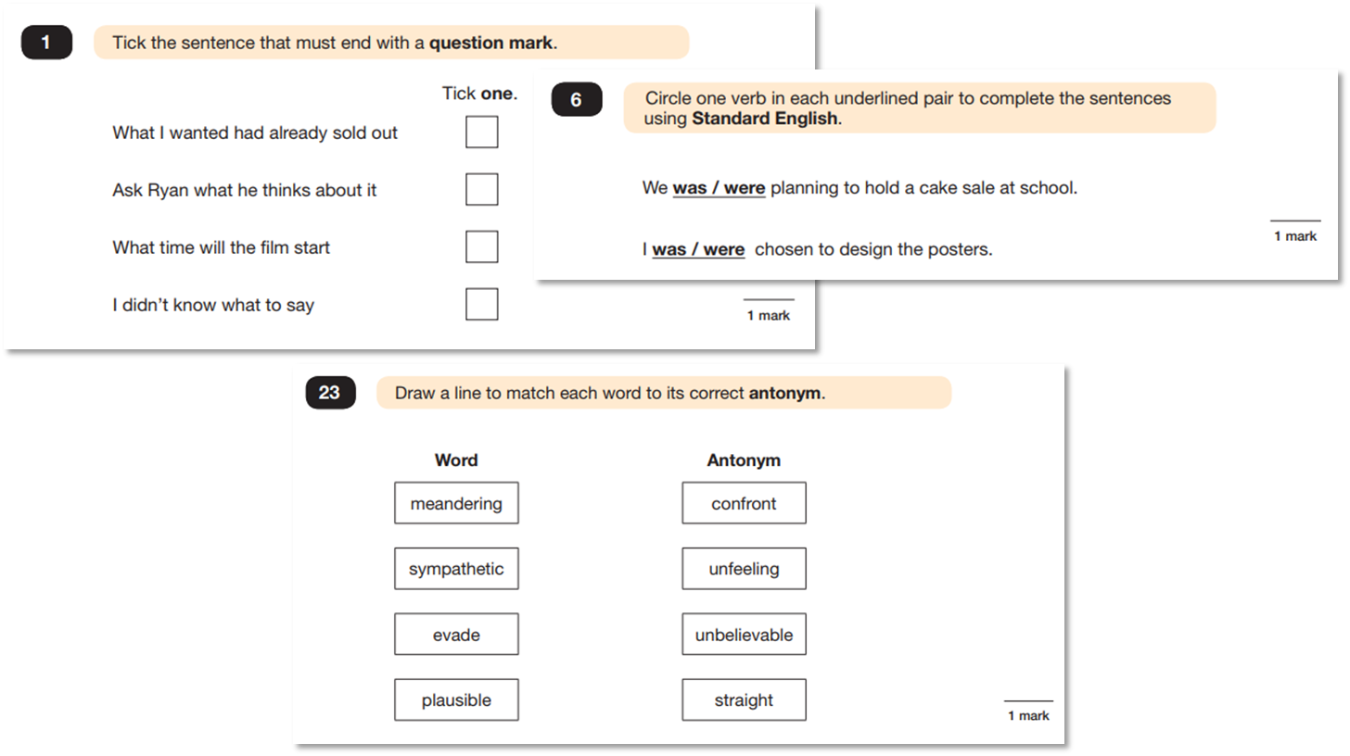

Slide 22
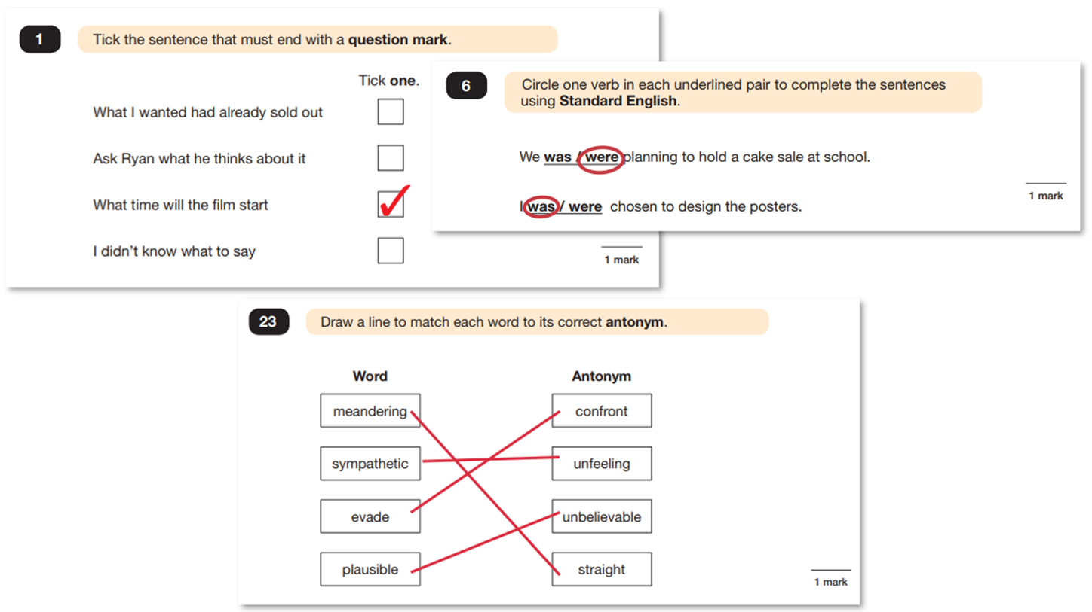

Slide 23
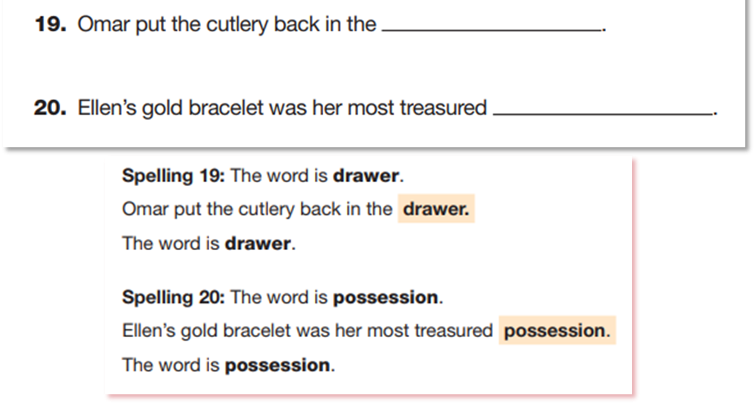
Monday 11th May 2026
Paper 2: Spelling
This is the shortest paper. It is not strictly timed; usually, it lasts around 15-20 minutes.
Teachers will read a word, read a sentence containing the word, then read the word again. Pupils will have ample time to write down the spelling of the word.

Slide 24
How can I help my child prepare for the SPAG paper?

Slide 25
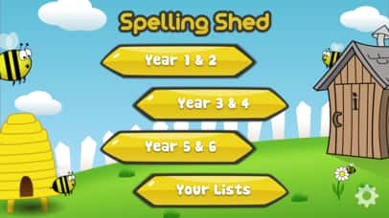

weekly spellings

Slide 26

practise at home

Slide 27
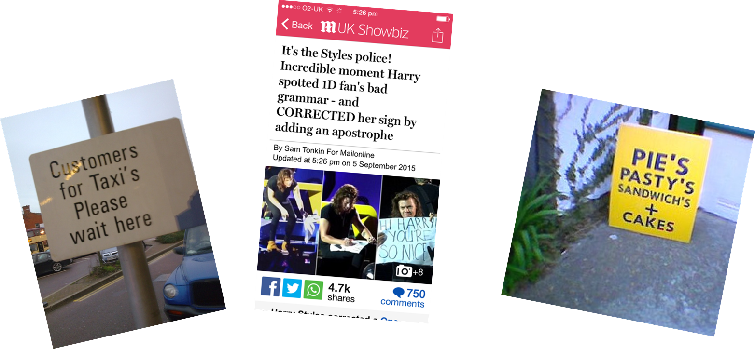
SPaG detectives

Slide 28


Youtube!

Slide 29


Slide 30
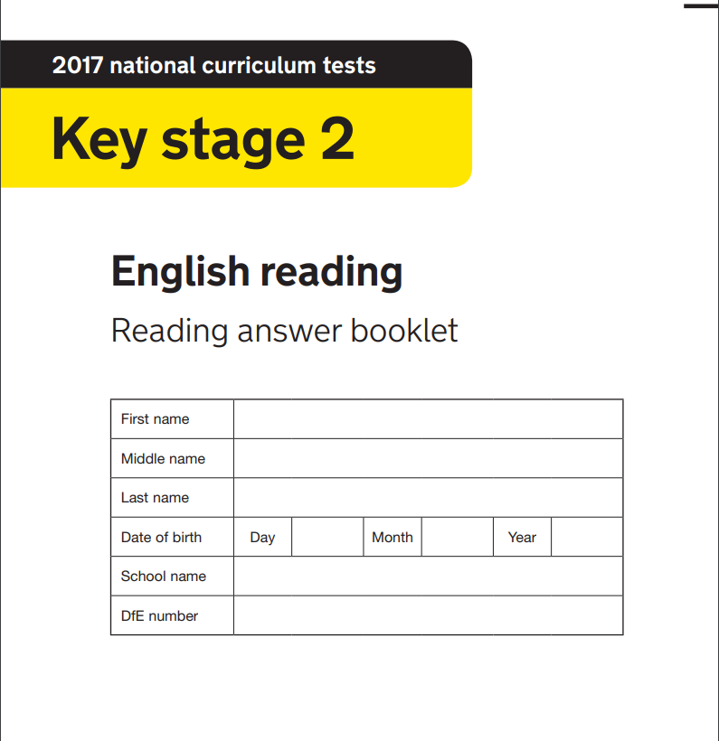
How can I help my child prepare for the reading paper?

Slide 31
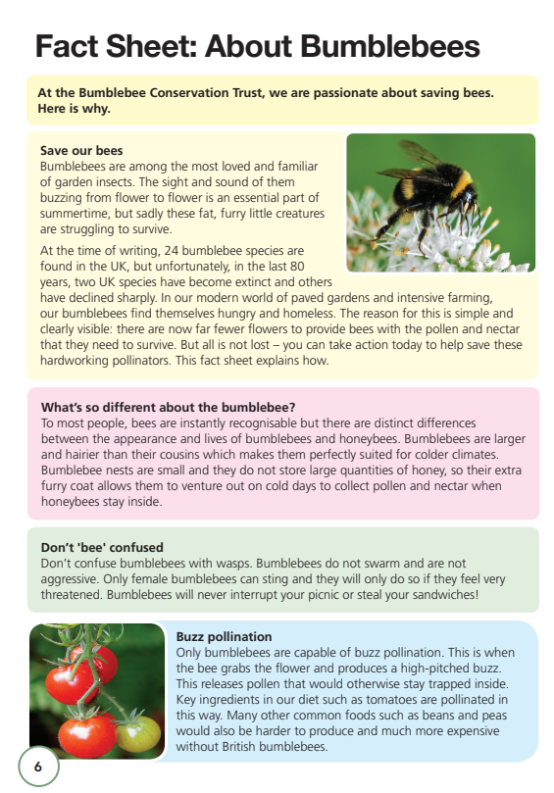
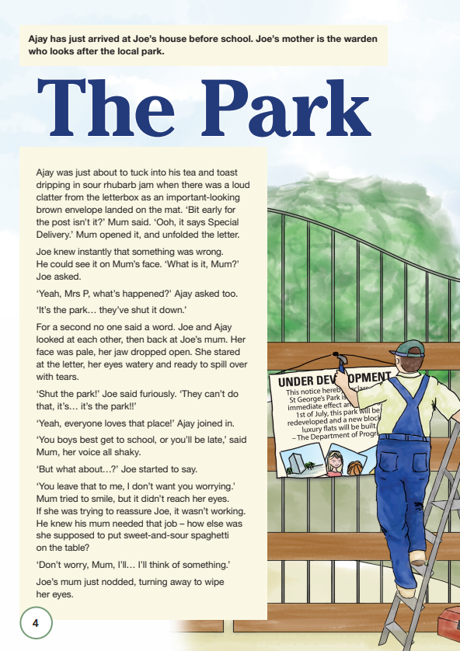
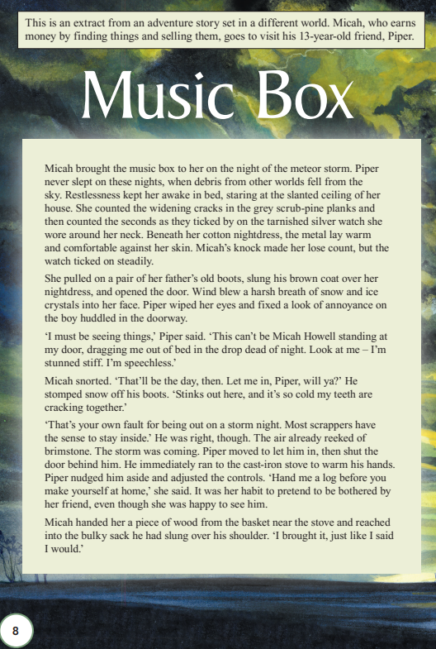
Tuesday 12th May 2026
1 hour
3 texts
50 marks

Slide 32
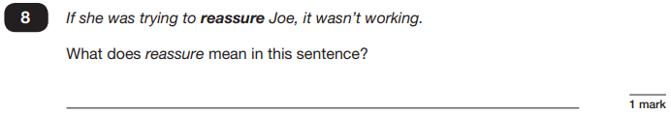



This exam tests your child’s comprehension of both fiction and non-fiction texts.
The most marks are awarded for the following skills:
Give/explain the meaning of words in context.
Retrieve information from the text.
Make inferences from the text.

Slide 33


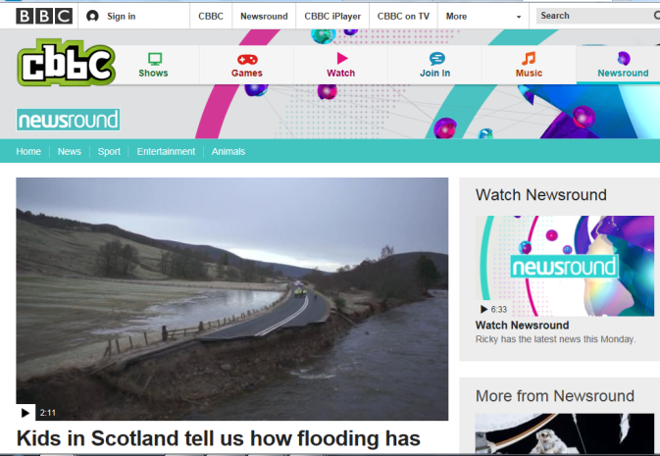



1 – Read with your child and question their understanding. Ask them to find information, to explain what particular words mean, to give a synonym for a particular word, to explain how a character feels, to explain why something has happened etc.
2 – Ask your child about their word count or recent quiz scores.
3 – Read and talk about the news together.
4 – Explore new vocabulary together.

Slide 34



Read a variety of different types of text.
Remember that it’s all reading!

Slide 35

The Maths Tests

Slide 36
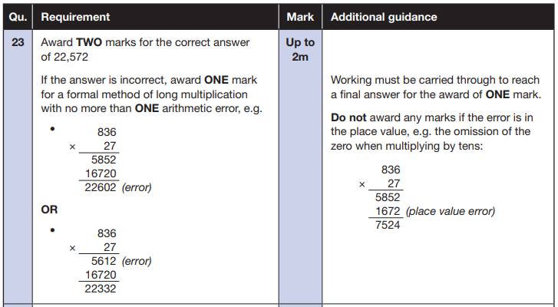
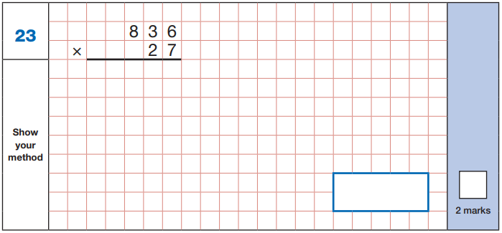
Maths Paper 1 (Arithmetic)
The maths arithmetic paper has a total of 40 marks.
The test covers the four operations (addition, subtraction, multiplication, division, including order of operations), percentages of amounts and calculating with decimals and fractions.
Example question:
Notes:
Identify that there are some questions that have 2 marks and some that have 1. If the answer to this question is wrong, children could still get a mark for a correct method containing an error.

Slide 37
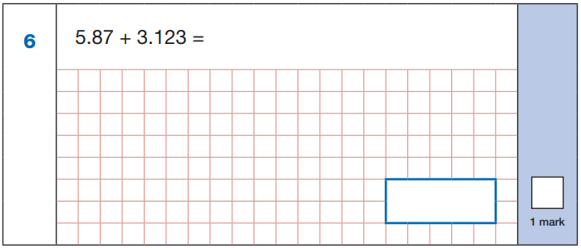
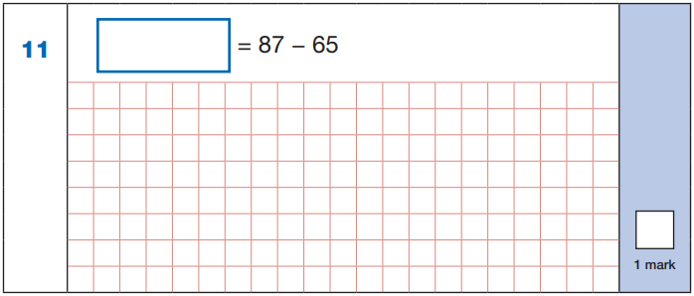

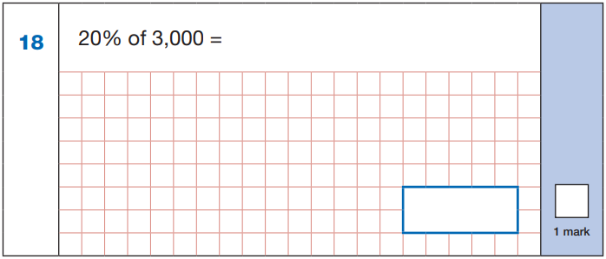
Maths Paper 1 (Arithmetic)
Example questions:
22
5.87
+ 3.123
8.993
87
- 65
22
8.993
60 ÷ (30 - 24)
60 ÷ 6 = 10
10% of 3,000 = 300
20% of 3,000 = 600
10
600
Notes:
These are examples of how children could solve the calculations. There are some that could/ should be solved mentally as it is far quicker that way (40 marks in 30 minutes does not allow for 1 minute + per mark).
Answers should always be given in their simplest form unless stated otherwise (e.g. for question 11, 20 + 2 would not be accepted as a correct answer).

Slide 38
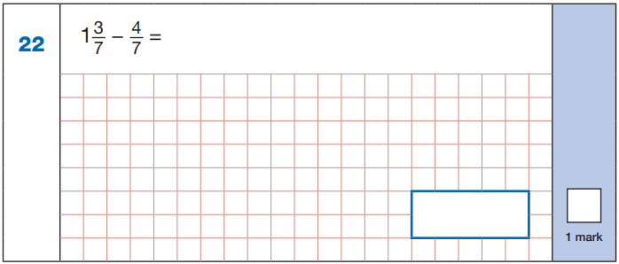
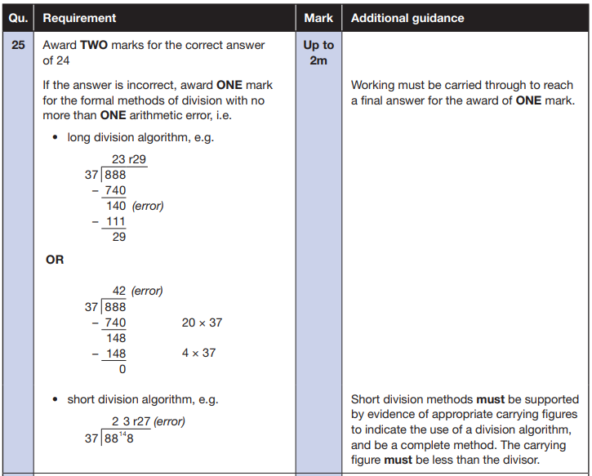
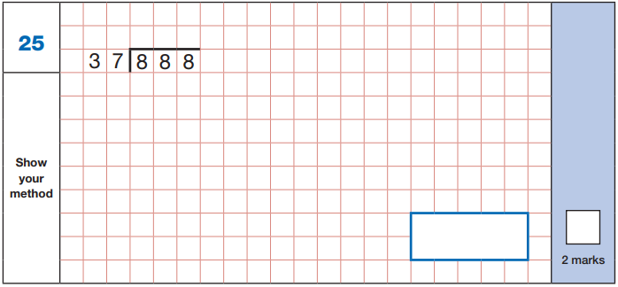


Maths Paper 1 (Arithmetic)
Example questions:
$\frac{\text{10}}{\text{7}}$ - $\frac{\text{4}}{\text{7}}$ = $\frac{\text{6}}{\text{7}}$
$\frac{\text{6}}{\text{7}}$

Slide 39
Maths Papers 2 and 3 (Reasoning)
These tests have a total of 35 marks each.
These papers require children to demonstrate their mathematical knowledge and skills, as well as their ability to solve problems and their mathematical reasoning. They cover a wide range of mathematical topics from key stage 2 including,
Number and place value (including Roman numerals);
The four operations;
Geometry (properties of shape, position and direction);
Statistics;
Measurement (length, perimeter, mass, volume, time, money);
Algebra;
Ratio and proportion;
Fractions, decimals and percentages.
Notes:
In general, the questions get progressively harder throughout the paper. As this is the case, it is not unusual for children to be unable to complete the entire paper in the given time. Maths Paper 1 (Arithmetic)

Slide 40
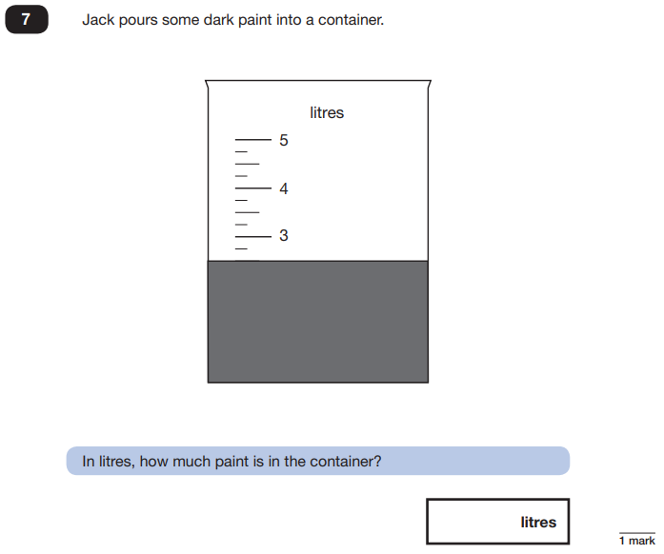
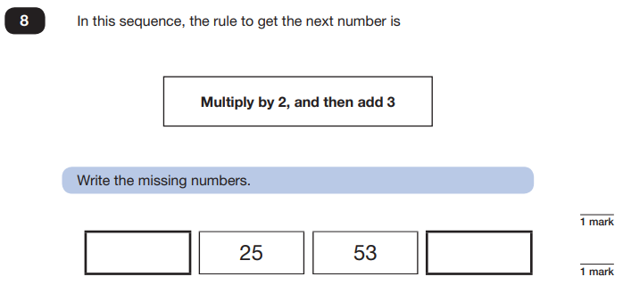
Maths Papers 2 and 3 (Reasoning)
Example questions:
11
109
2.5 or 2 ½

Slide 41
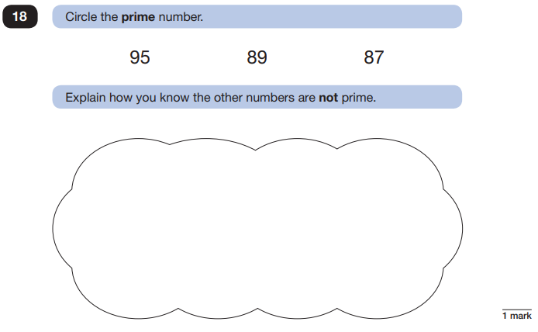
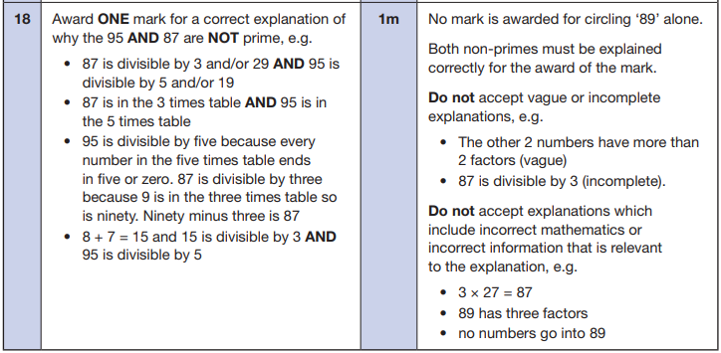
Maths Papers 2 and 3 (Reasoning)
Example question:
Notes:
This question is an example where pupils will need to justify their answer.

Slide 42
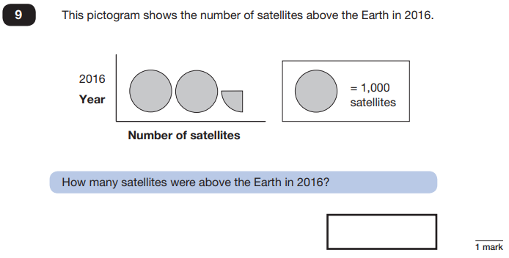
Maths Papers 2 and 3 (Reasoning)
Example questions:
2,250
Notes:
Question 9: Pictograms are part of the Year 3/ 4 curriculum.

Slide 43
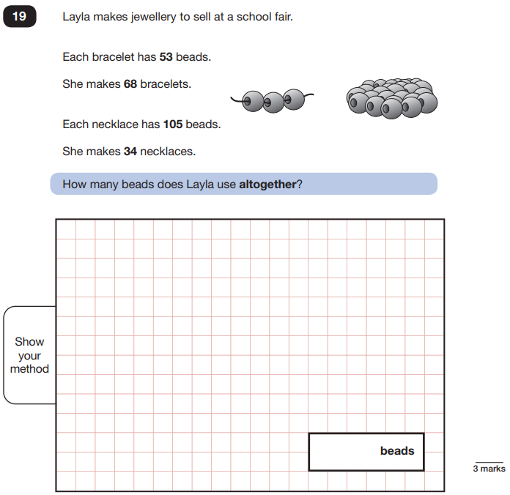
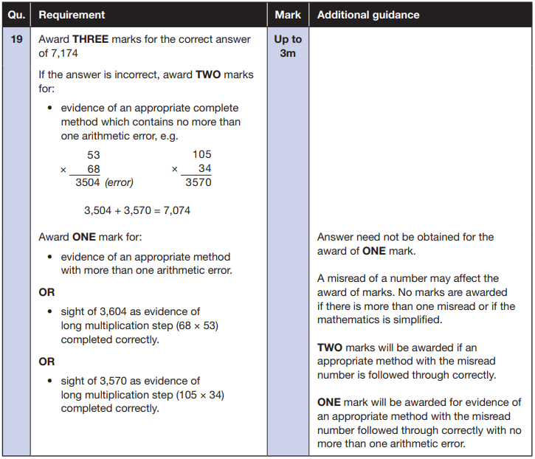
Maths Paper 3 (Reasoning)
Example question:
Notes:
Note that this is a three mark question.

Slide 44
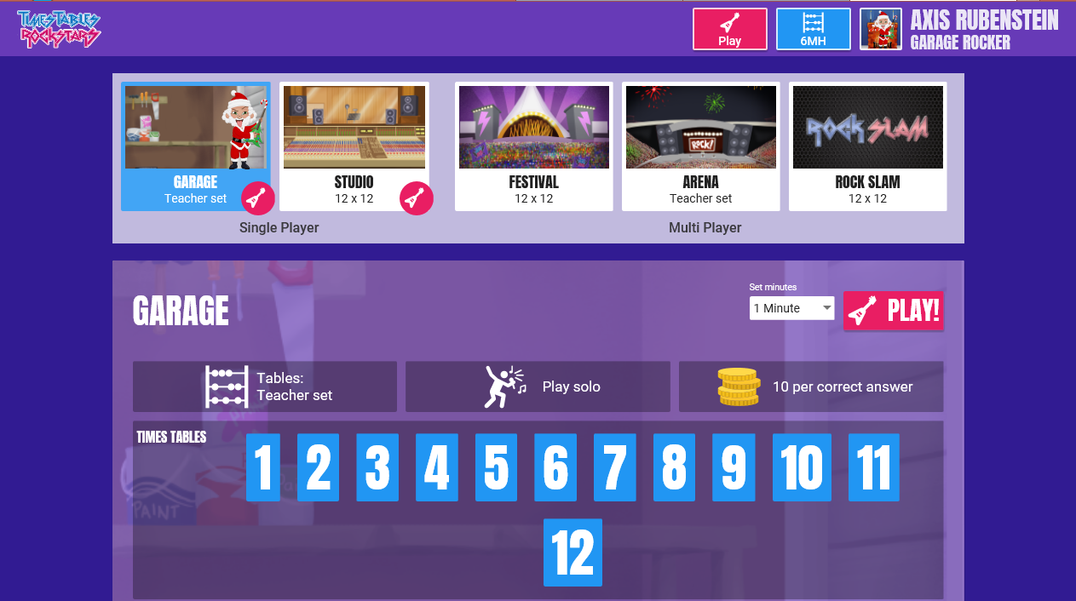
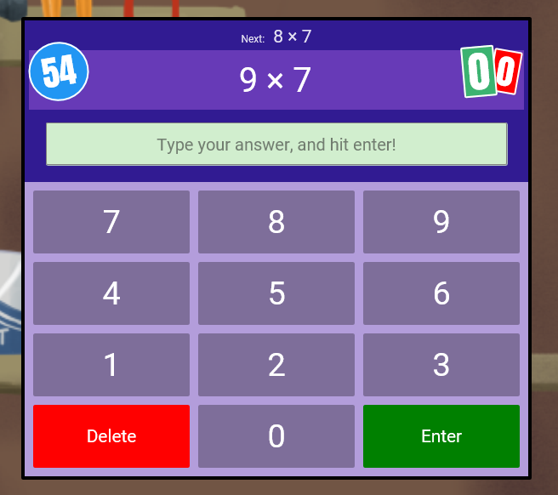
How can you help?

Slide 45
Times Tables
Pupils need to know their timetables to x12.
These are the expectations at the end of Year 4
Help your child with their timetables at home – it supports ALL areas of maths.

Slide 46

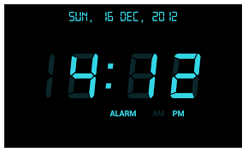


Slide 47


